Slide 1

Screen Time and Self-Esteem: A Deep Dive into Social Media's Impact on Adolescents.

Slide 2



Significance to the Research Problem
54% of Teenagers struggle to imagine life without social media, especially pronounced among girls and older teens. (Pew Research Center, 2022)
Almost all U.S. teens report using the internet daily. (Pew Research Center, 2022)
Majorities of teens use YouTube and TikTok every day, and some report using these sites almost constantly. (Pew Research Center, 2023)

Slide 3
Significance to the Research Problem
Twenge & Campbell (2018): Found a correlation between increased screen time and lower self-esteem in adolescents.
Valkenburg & Peter (2009): Discussed how social media uniquely affects psychological states compared to non-social digital activities.
Sherman et al. (2016): Explored the emotional motivations behind social media use, highlighting the influence of social validation and peer comparison on self-esteem.

Slide 4
Research Question
How does screen time, specifically through social media usage, impact the self-esteem of teenagers?
'Social media' in this study refers to platforms like Instagram, TikTok, Snapchat, and YouTube, focusing on their unique engagements and potential influences on teenagers' self-esteem.

Slide 5
Aims and Objectives
Quantify
Quantify average social media screen time among teenagers.
Assess
Assess self-esteem variations with different social media engagement levels.
Identify
Identify specific social media experiences that significantly affect self-esteem.
Propose
Propose strategies to mitigate negative impacts, promoting positive online experiences.

Slide 6
Key Literature Related to the Project
Tim Walker (2021) discusses increased screen time's negative effects on student mental health and body image, especially among teenage girls.
Silva Santos et al. (2023) review highlights the nuanced impacts of screen time on adolescent mental health, indicating a significant link between increased screen time, especially on smartphones and social media, and diminished mental health.
This literature underscores the urgent need for focused research into the 'why' and 'how' behind screen time's impact on mental health.

Slide 7
Methodology/Development Strategy
Adopting a mixed-methods approach, integrating quantitative surveys with qualitative interviews to explore the varied effects of social media usage on self-esteem.
Surveys will use the Rosenberg Self-Esteem Scale for validated self-esteem measures, alongside questions on screen time and social media usage.
In-depth, semi-structured interviews will provide qualitative insights into teenagers' personal experiences with social media.
"On the whole, I am satisfied with myself.“
"At times I think I am no good at all.“
"I feel that I have a number of good qualities."

Slide 8
Ethical Considerations and Risk Assessment
Confidentiality
Ensure confidentiality and data security throughout the research process.
Consent
Obtaining informed consent from all participants, with parental consent for those under 18, is paramount given the focus on minors.

Slide 9
Description of Artefacts That Will Be Created
Social Media Well-being Toolkit: A compilation of strategies for healthy social media use among teenagers.
Screen Time Monitoring App: A tool designed to help teenagers and families manage digital habits for a balanced online-offline life.

Slide 10
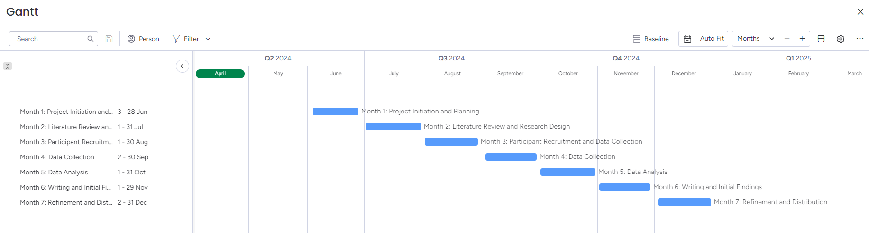
Timeline of Proposed Activities

Slide 11
Thank you

